Slide 1
Lynch Syndrome Genes
Pancreatic and Gastric

Slide 2
MLH1 and MSH2
Pancreatic and gastric

Slide 3
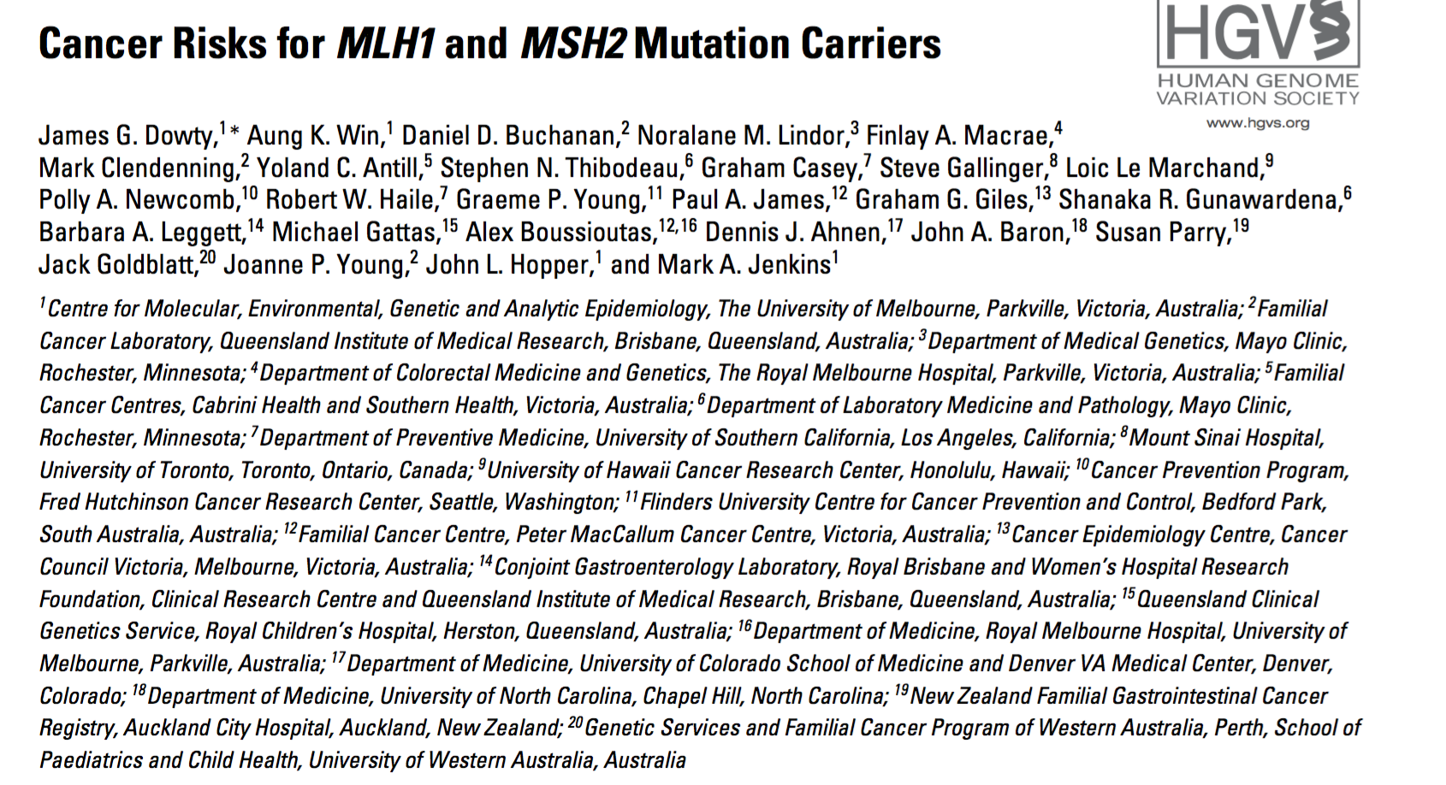

Slide 4
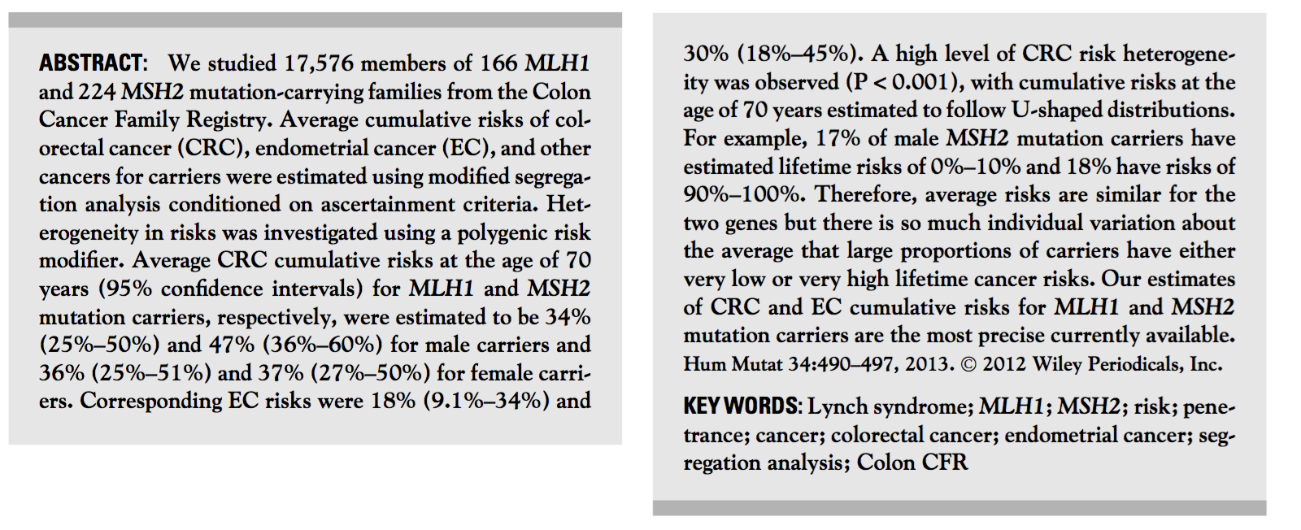

Slide 5
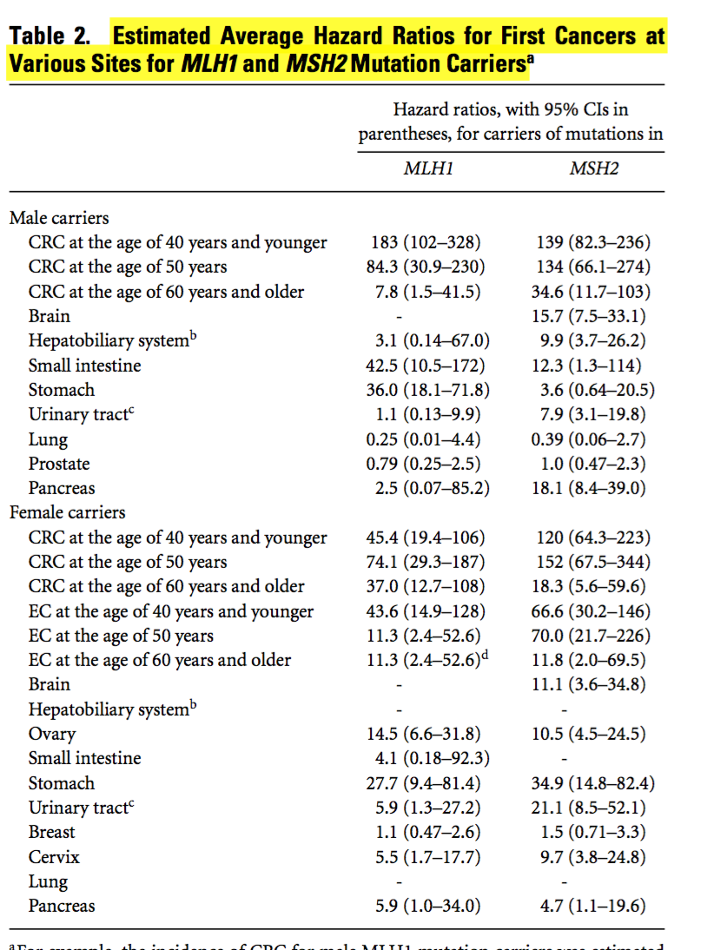

Slide 6
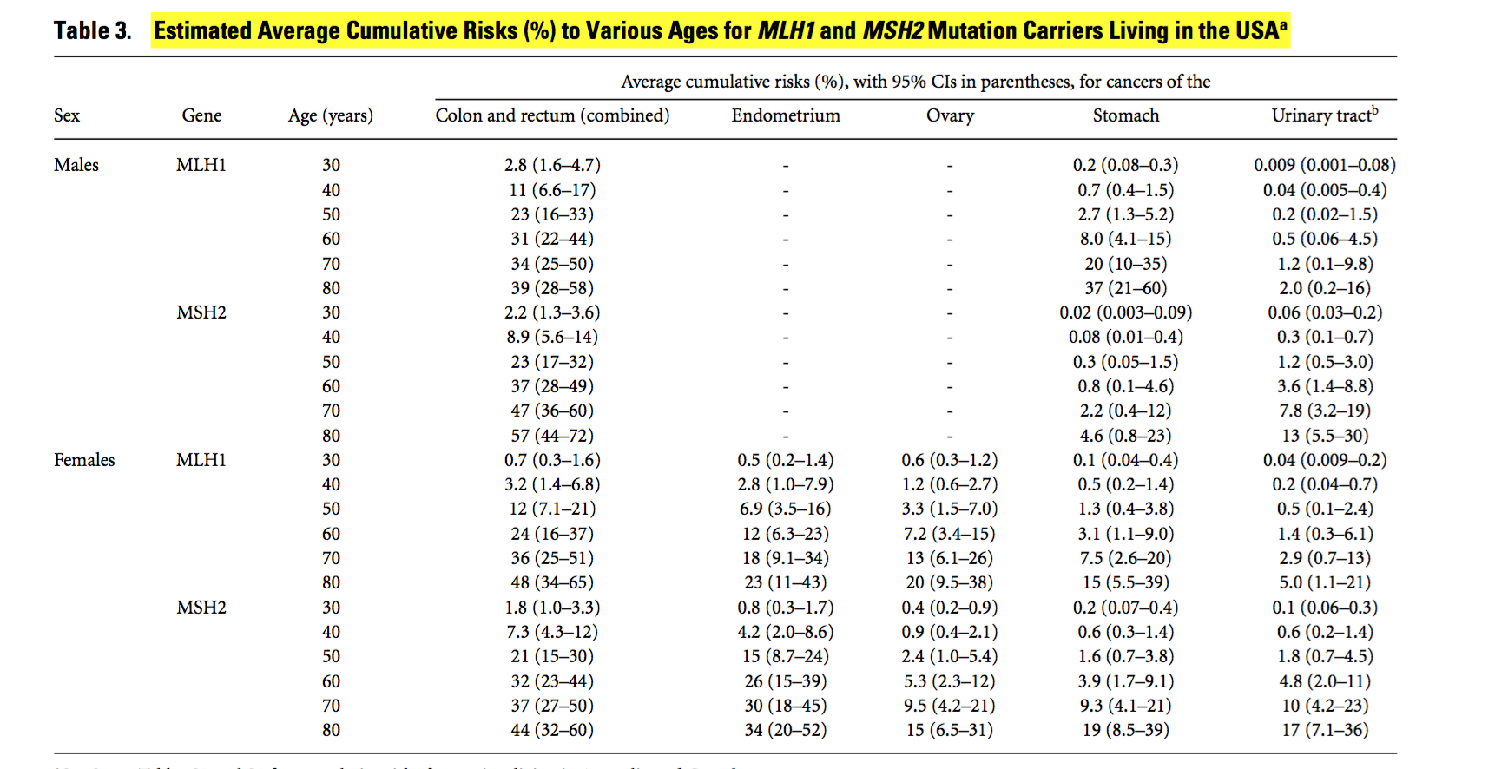

Slide 7
MSH6

Slide 8
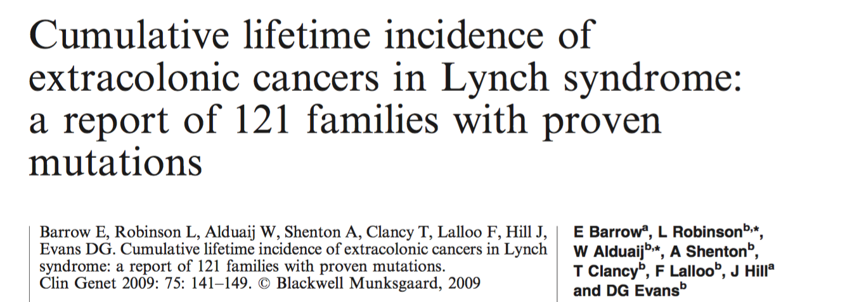

Slide 9
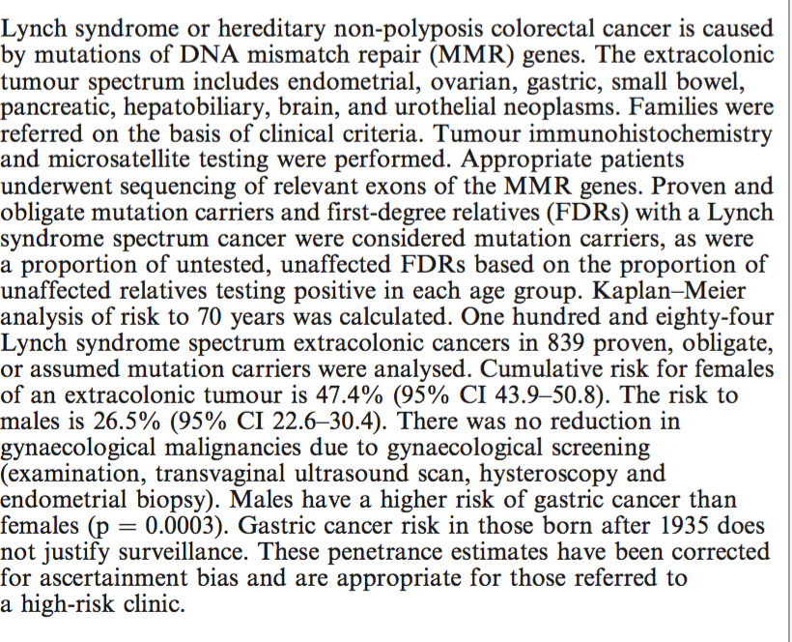

Slide 10
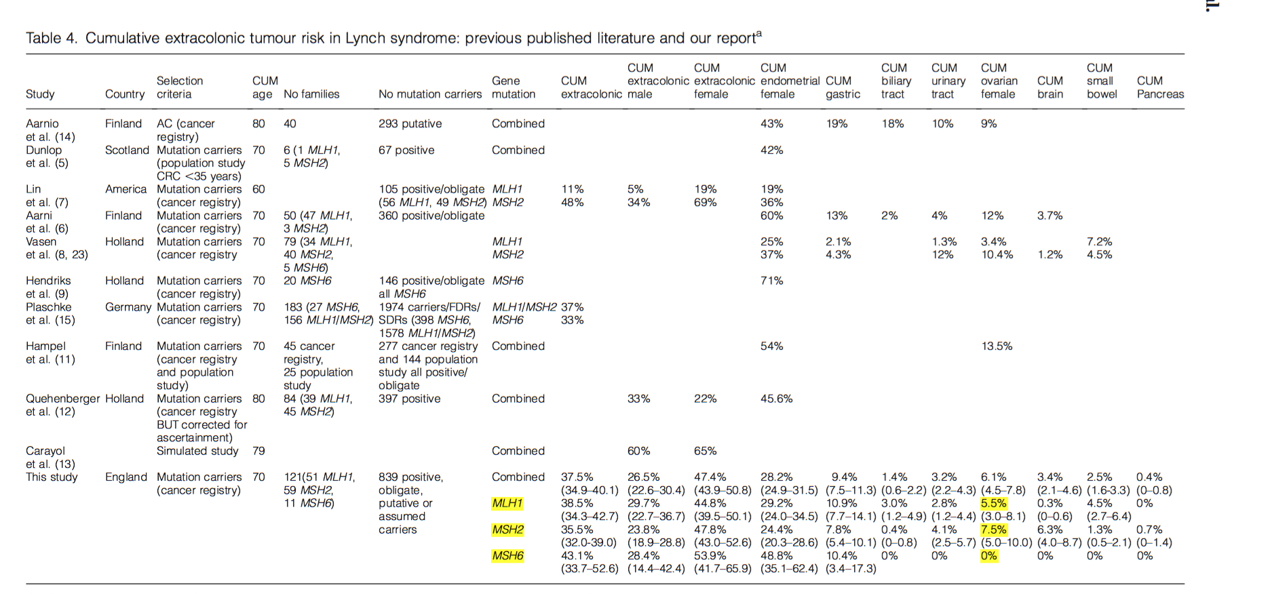

Slide 11
